Slide 1
Job Flow : Resume Shortlist Assistant
Present by: Shah Diya R.

Slide 2
Outline
Abstract
Introduction
Literature survey
Proposed system
Diagrams
Implementation
Conclusion and future work
References

Slide 3
Abstract
In today's fast-paced digital world, traditional job search methods are inefficient.
JobFlow provides an efficient platform for candidates and employers.
Features:
Resume uploads
Smart resume filtering
Job search with filters
Company dashboards
Real-time application tracking
Built using Flutter and Firebase for cross-platform compatibility and secure data handling.

Slide 4
Introduction
Hiring challenges include manual resume screening and inefficient communication.
JobFlow simplifies the job search and recruitment process.
Objectives:
Help job seekers easily find and apply for jobs.
Assist companies in finding qualified candidates faster.

Slide 5
Literature Survey
Existing Systems:
LinkedIn, Indeed, Naukri, Monster, Glassdoor.
Problems Identified:
Time-consuming manual resume review.
Lack of personalized job recommendations.
Delayed employer responses.
Solution Proposed:
Smart resume filtering based on job descriptions.
Real-time updates to candidates.

Slide 6
Proposed System
Key Features of JobFlow:
Smart resume filtering using AI techniques.
Cloud-based resume storage for easy access.
Real-time notifications about job application status.
Direct communication between companies and candidates.
Secure authentication using Firebase.
Benefits:
Time-saving for HR departments.
Easy application tracking for candidates.
Improved hiring quality through better matches.

Slide 7
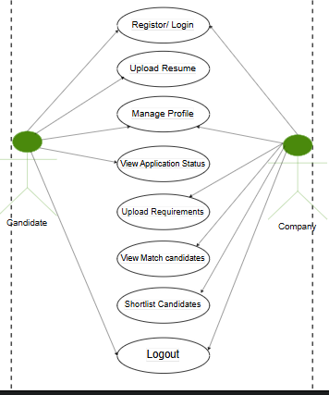
Diagrams
Use Case:

Slide 8
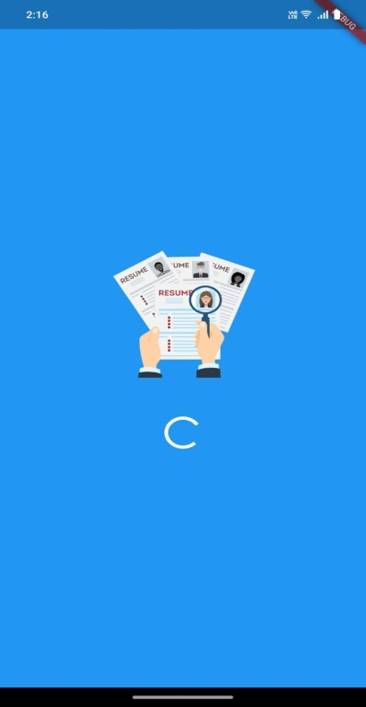
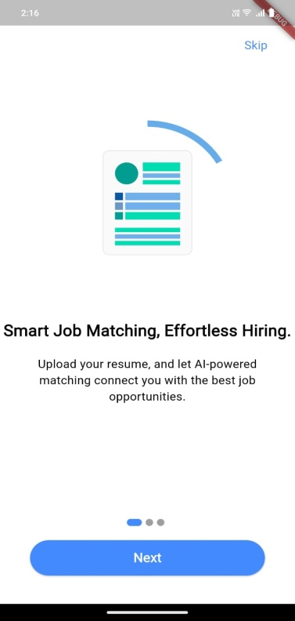
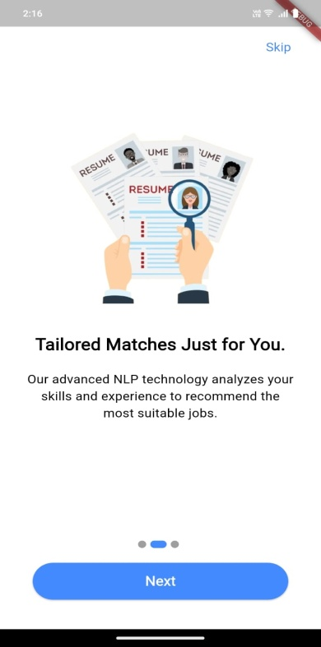
Implementation:welcome screens

Slide 9
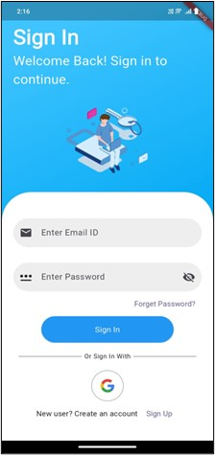
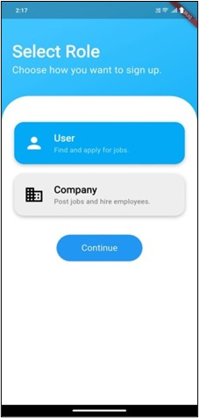
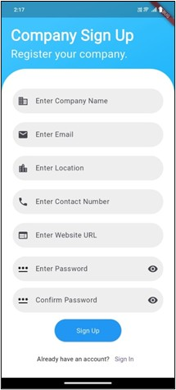
Implementation:Authentication

Slide 10
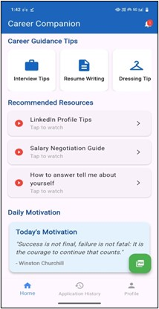
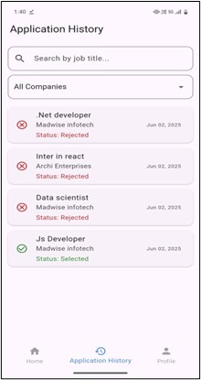
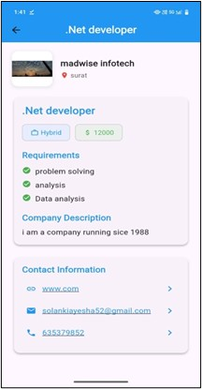
Implementation:Candidate side

Slide 11
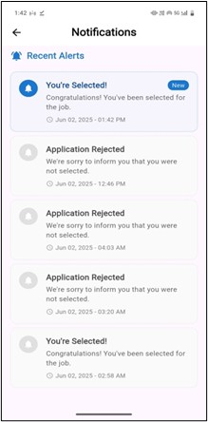
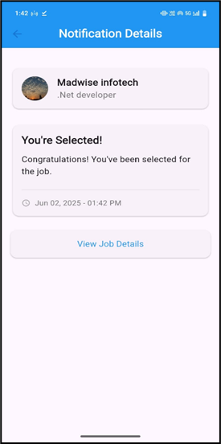
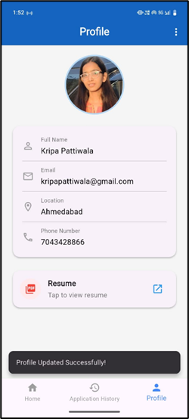
Implementation:Candidate side

Slide 12
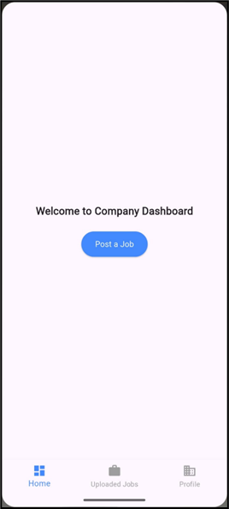
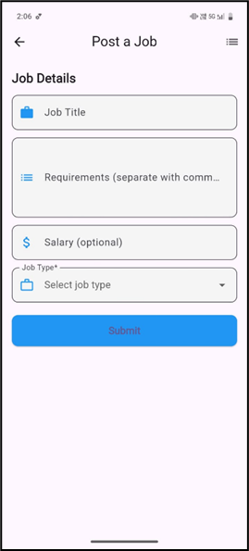
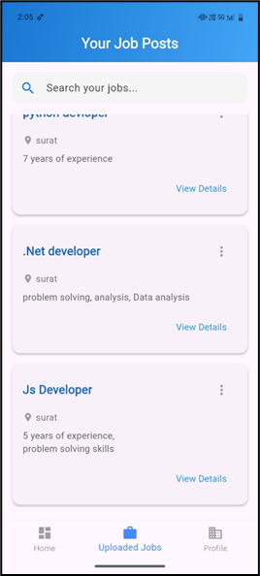
Implementation:Company side

Slide 13
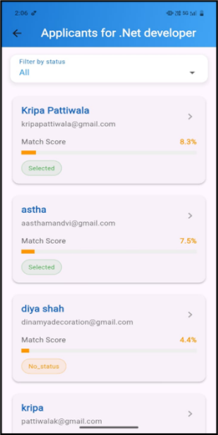
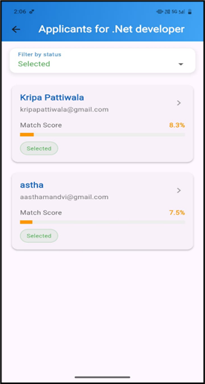
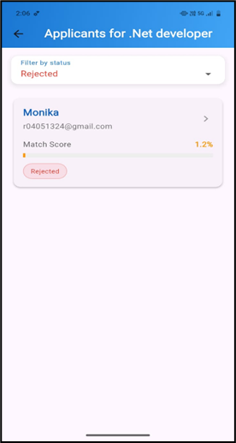
Implementation:Company side

Slide 14
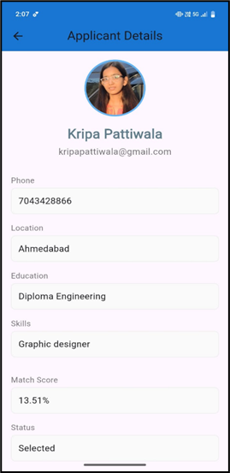
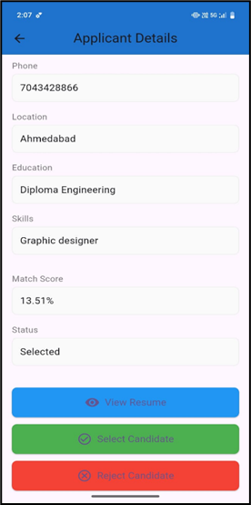
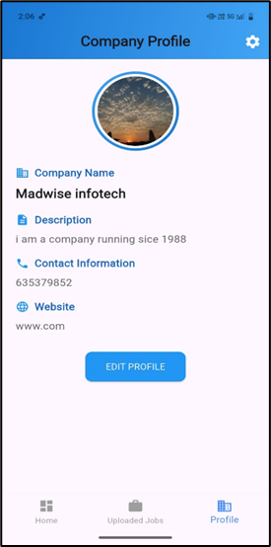
Implementation:Company side

Slide 15
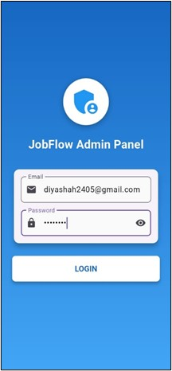
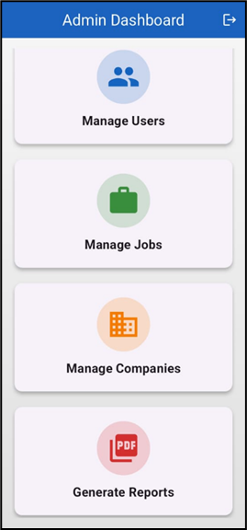
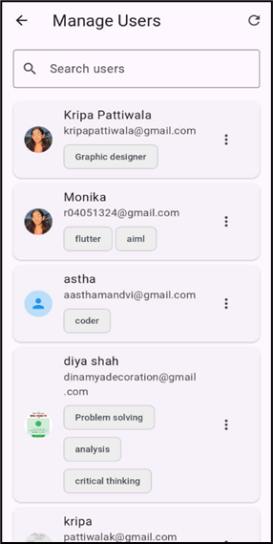
Implementation:Admin side

Slide 16
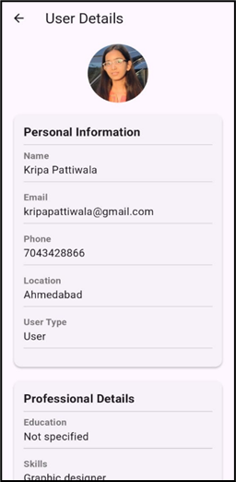
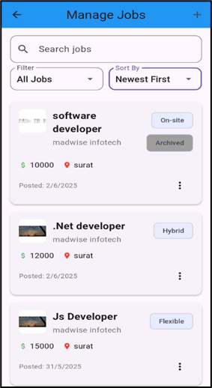
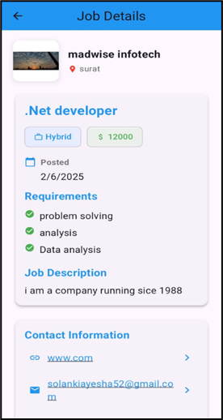
Implementation:Admin side

Slide 17
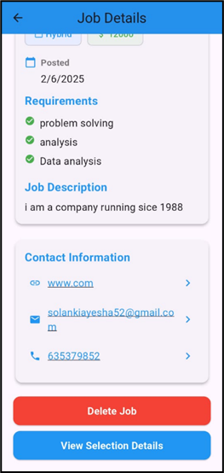
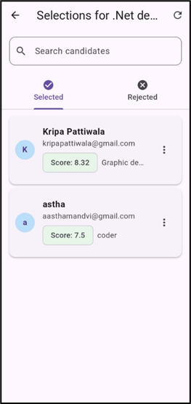
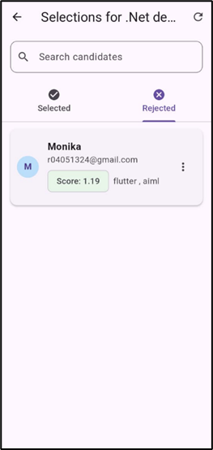
Implementation:Admin side

Slide 18
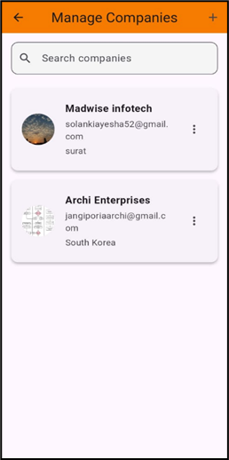
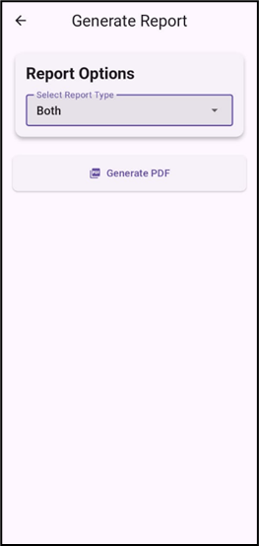
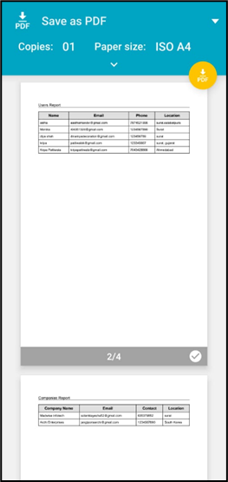
Implementation:Admin side

Slide 19
Conclusion and future work
Conclusion:
The Job Portal System was developed to simplify the job search and hiring process by providing an efficient platform for both job seekers and employers. The system successfully enables functionalities like user registration, login, job posting, job searching, and application management. It creates a bridge between candidates and recruiters through an easy-to-use, secure, and responsive platform.
Future work:
Chatbot Integration: Implement a chatbot for easy and instant communication between companies and users, improving support and query handling.
On-App Interview and Quiz Module: Introduce online interviews and quiz assessments directly within the app to streamline the recruitment process.

Slide 20
References
Firebase Documentation: https://firebase.google.com/docs
Flutter Official Documentation: https://docs.flutter.dev/
FlutterFire (Firebase for Flutter) Documentation: https://firebase.flutter.dev/
Dart Programming Language Documentation (for Flutter): https://dart.dev/guides
Draw.io (for Diagram Drawing Online): https://app.diagrams.net/
PlantUML (for Code-based Diagrams): https://plantuml.com/
DeepSeek Ai
OpenAi
Lottie images
Stack Over Flow

